Slide 1
ADP Internship fy’24
Gayatri Ankam
Sep 2023

Slide 2
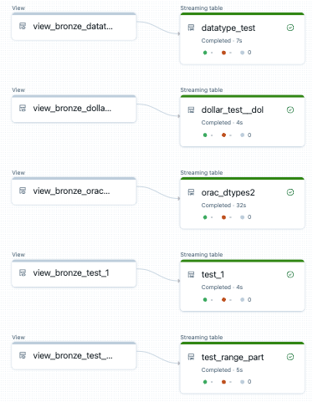
Problem statement
When a streaming job is run, it emits structured streaming metrics such as, input rate, process rate and batch duration. These metrics play a major role in monitoring the performance of the stream. There exists no unified view for these metrics to be queried on.
In a bug identified in the Databricks, the pipeline runs fine but there is no progress made by the pipeline, which gives a false impression that the pipeline is working fine. There is no log kept as to which batch last ran successfully before the pipeline stopped progressing.

Slide 3
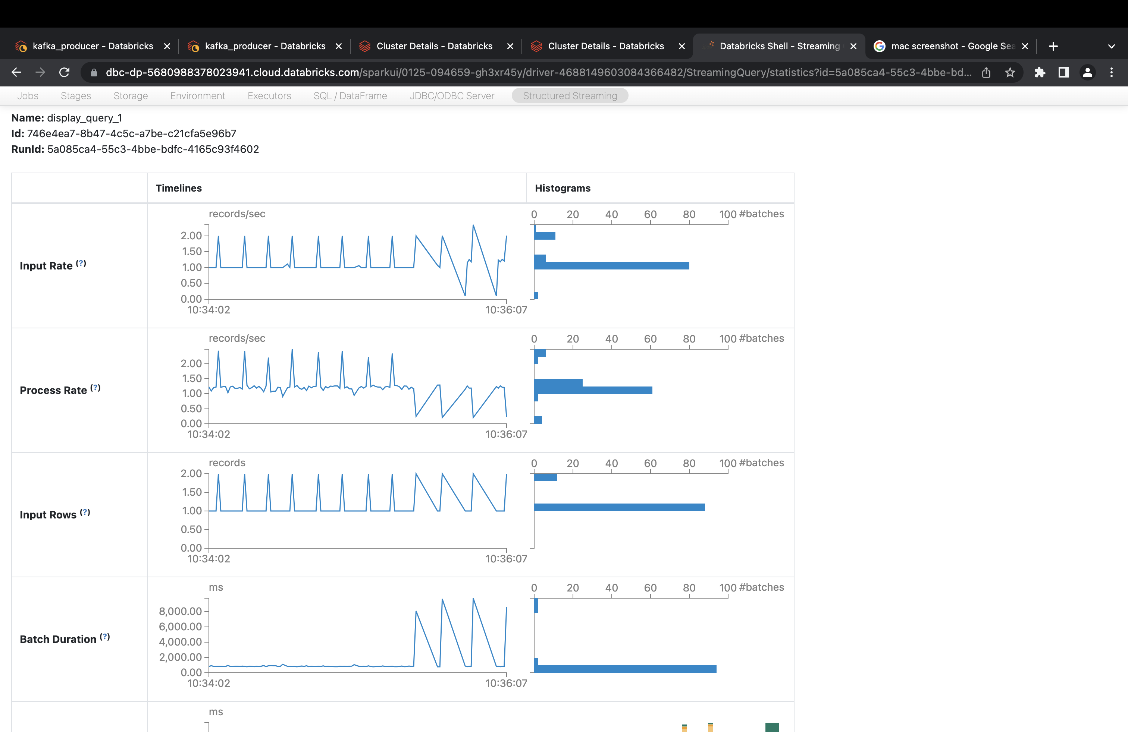
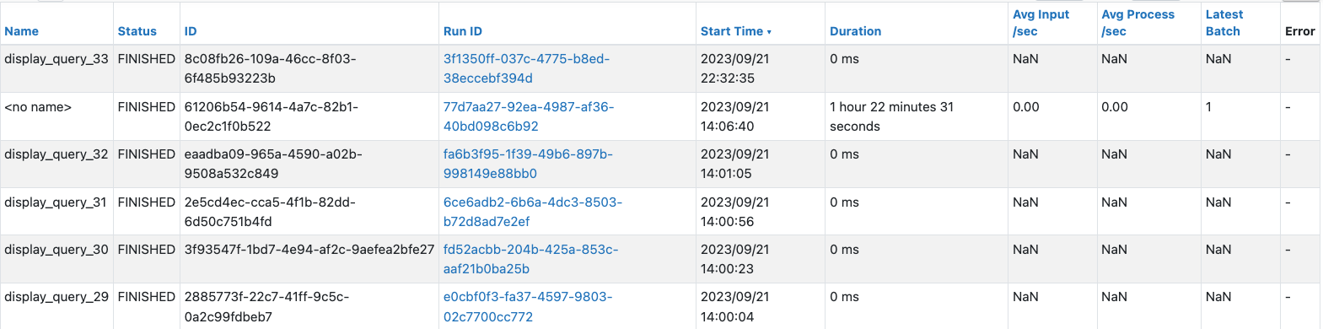
Existing system
Spark UI enables us to view these metrics for each query. These visualizations exists only on table level but there is no unified view on an app level, moreover, these are reset every time the pipeline restarts. Spark UI does not also show a timestamp when a batch was last run for each pipeline.

Slide 4
Project overview
The primary objectives of this project is to resolve the limitations by the following,
Centralizing these metrics into a dedicated delta table, where all the metrics are stored consistently regardless of pipeline restart.
Building a pipeline level table that shows the last time the batch ran.
Building a table level visualization to show the metrics as a table and line charts.
Adding filters such that the visualizations can be filtered by app, table or as of a particular timestamp.

Slide 5
Demo

Slide 6
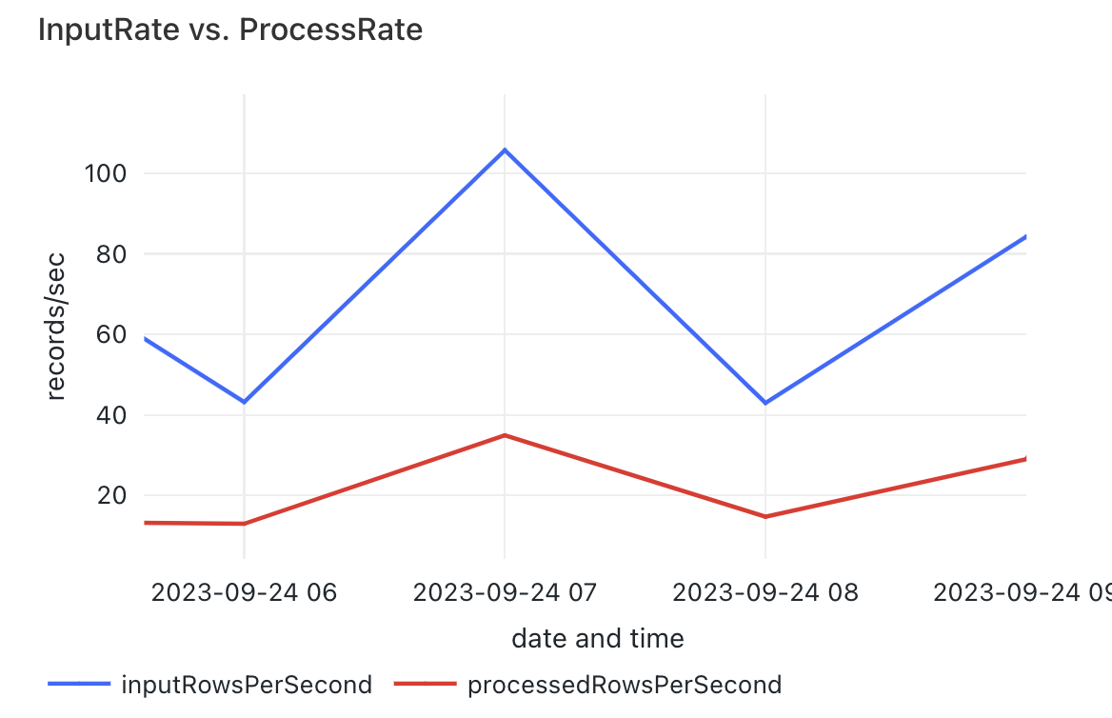
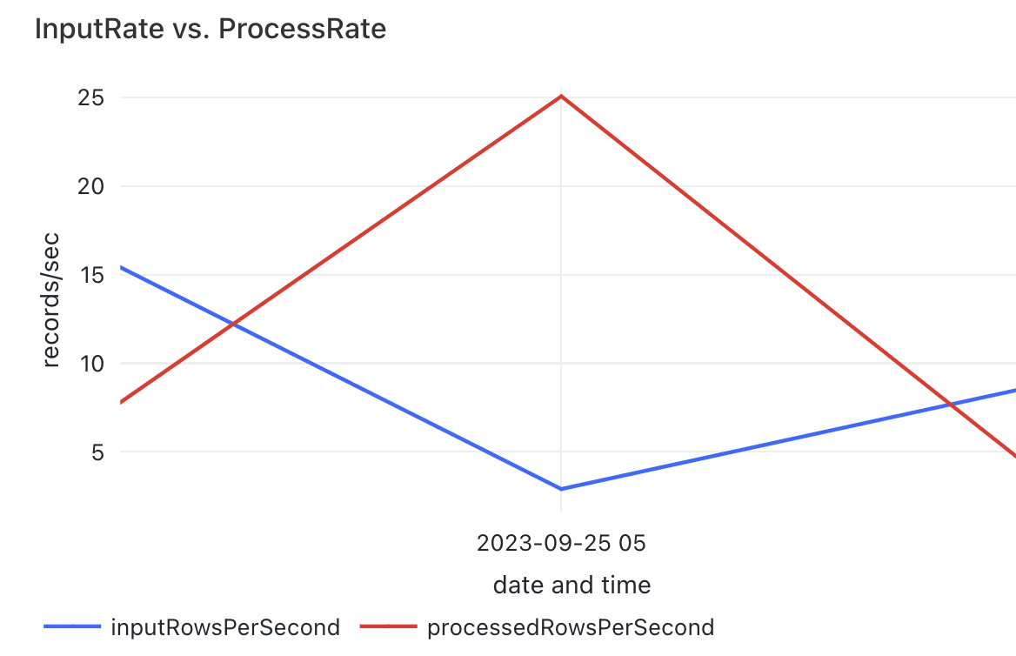
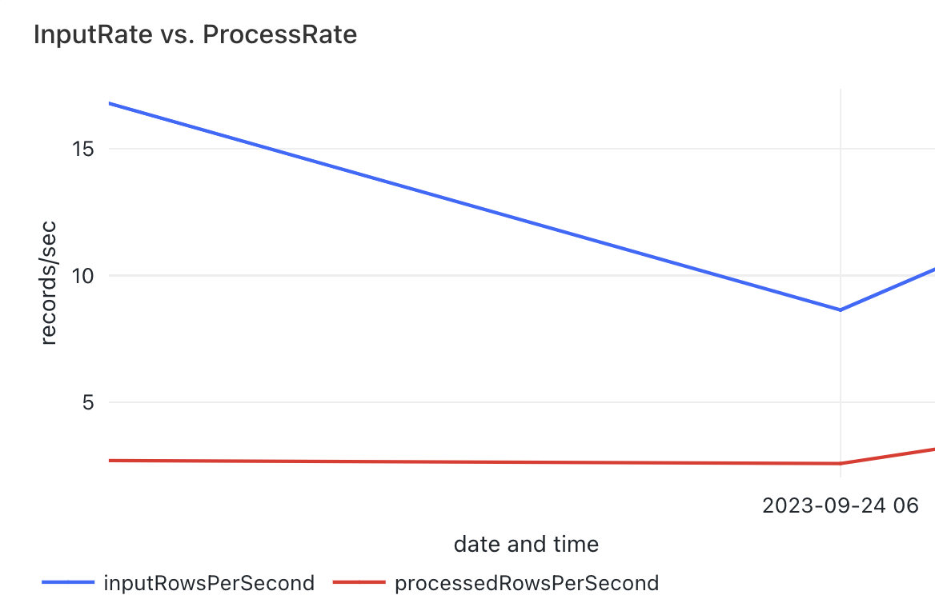
Observations
Input Rate and Process Rate increases or decreases in a similar pattern
Process Rate increases while Input Rate decreases
Input Rate decreases while Process Rate remains steady

Slide 7
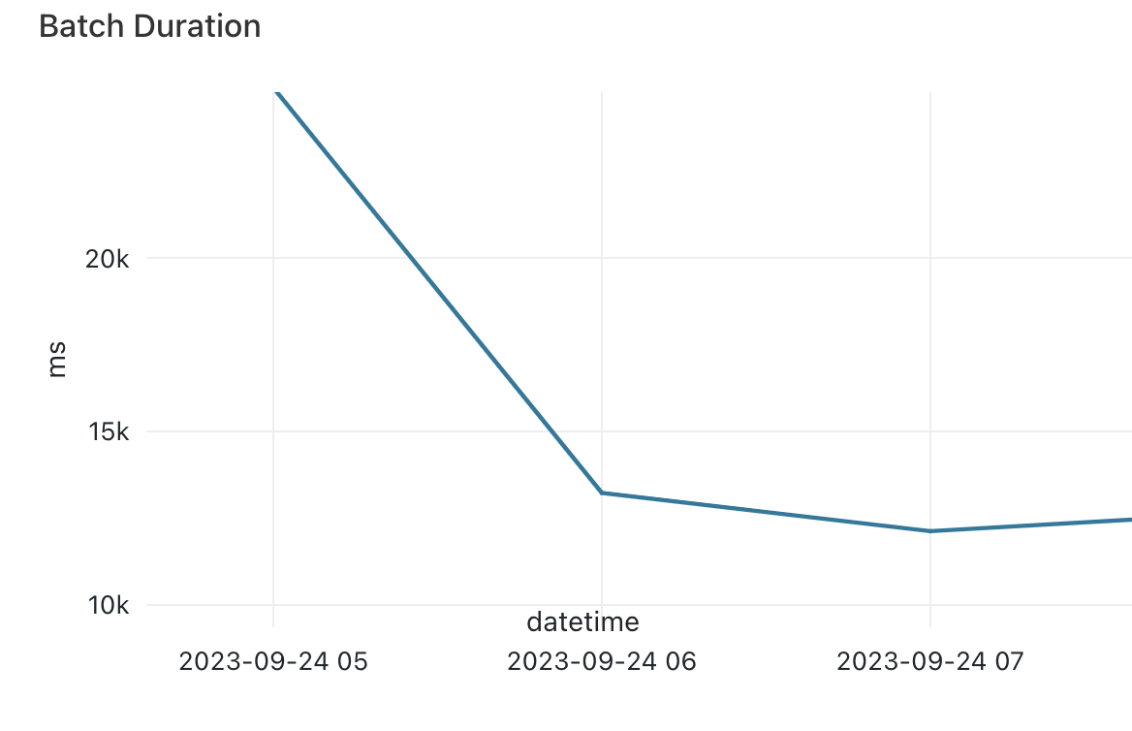
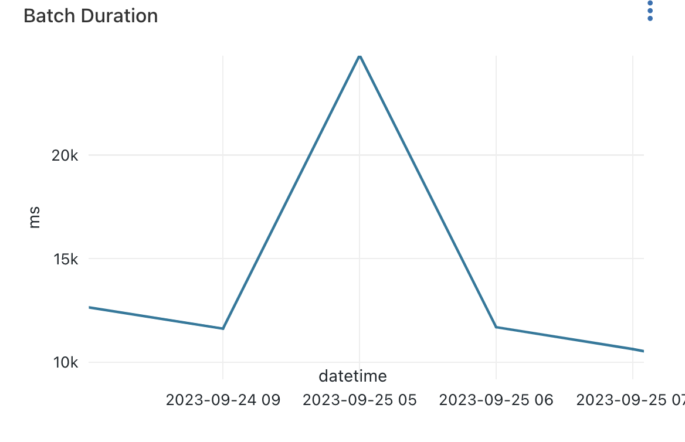
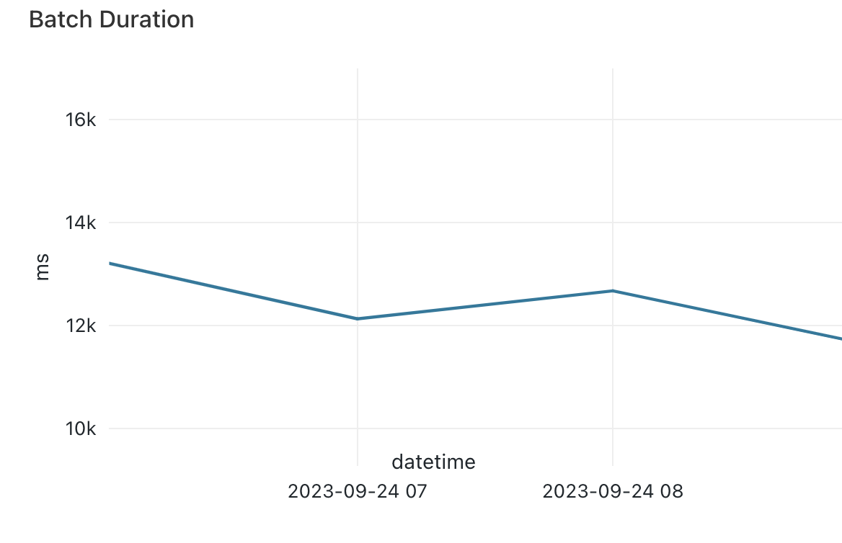
Observations
Decreasing Batch Duration
Increasing Batch Duration
Steady Batch Duration

Slide 8

Feedback and Suggestions

Slide 9
Thank You

